Slide 1
Groundwater Dynamics AWD
CT4420 illustrative addendum to chapter 5 of Groundwater Science

Slide 2
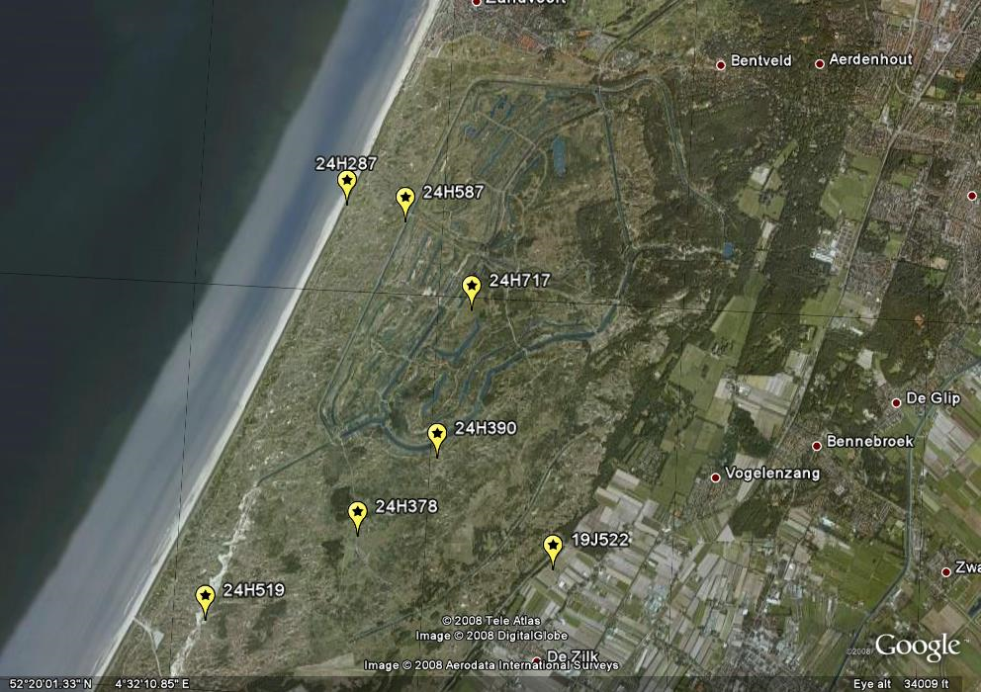
Amsterdam Water Supply Area with selected piezometer

Slide 3
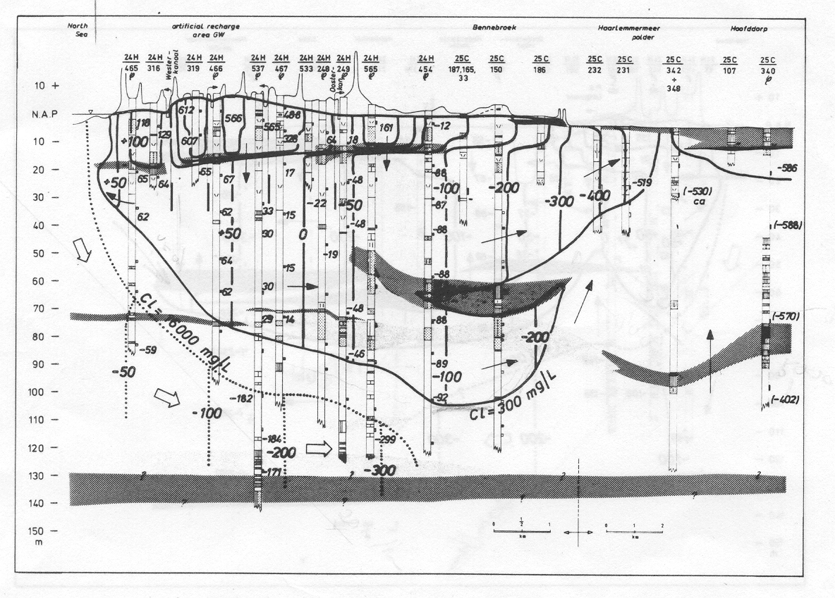
Cross section west-east

Slide 4
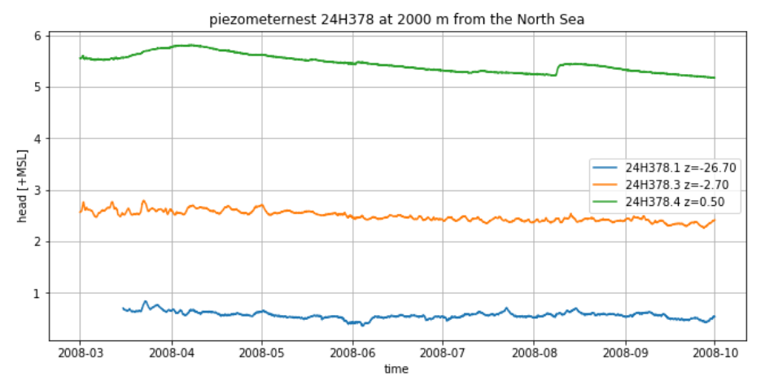
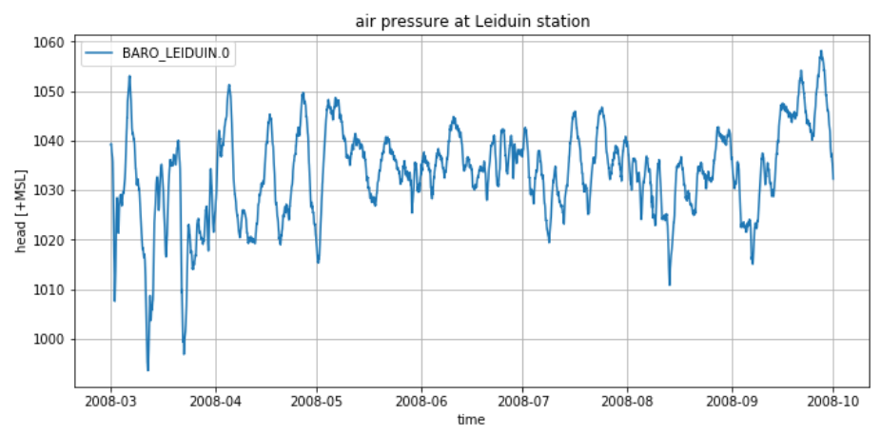
200 m south of Kromme Schuster AWD (confined head and barometer)

Slide 5
200 m south of Kromme Schuster AWD (confined head and barometer)
Barometer efficiency is ca. 75% in this shallow semi-confined aquifer

Slide 6
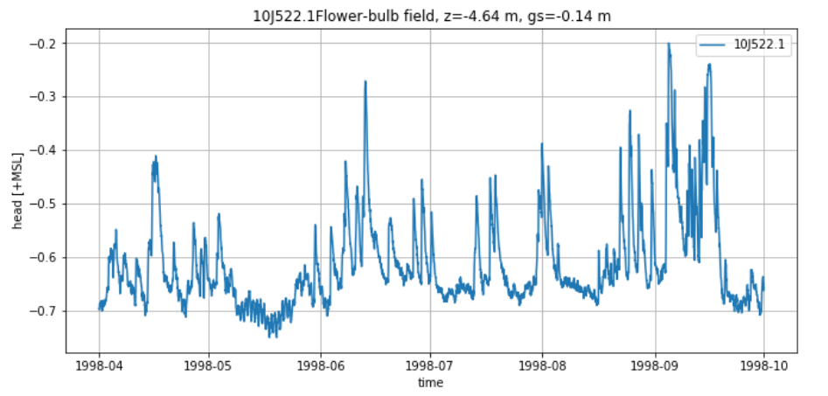
Flower bulb field De Zilk (shallow water table small system)

Slide 7
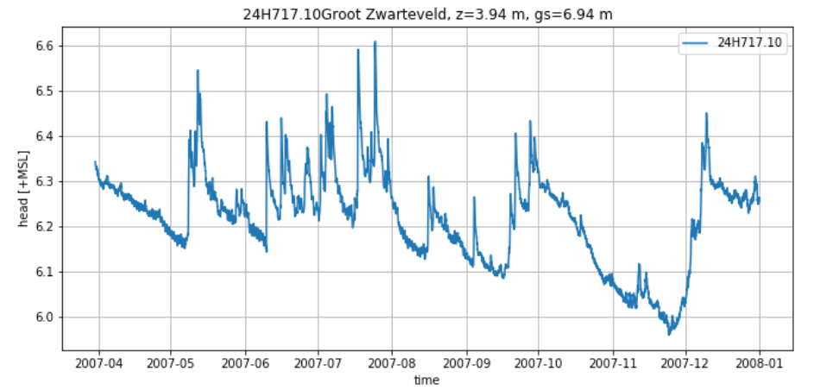
Groot Zwarteveld (shallow water table large system, summer)

Slide 8
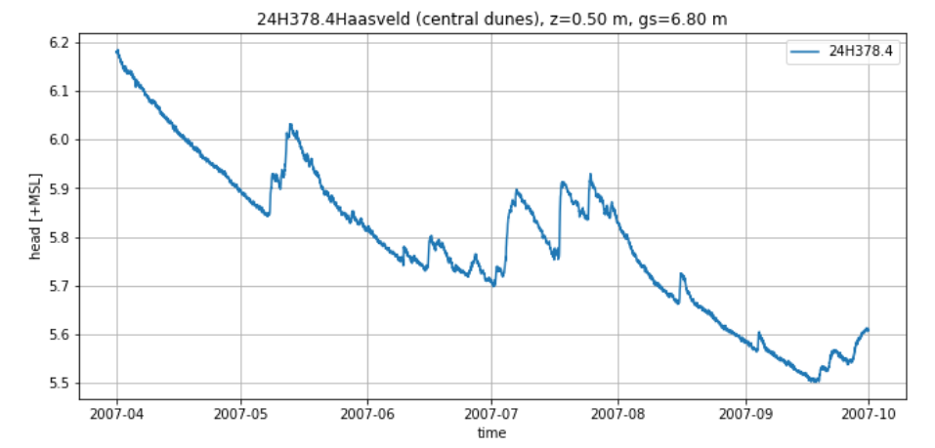
Haasveld central AWD (deep water table large system)

Slide 9
Tide North Sea IJmuiden lags 15 min behind Noordwijk (30 km to the south)

Slide 10
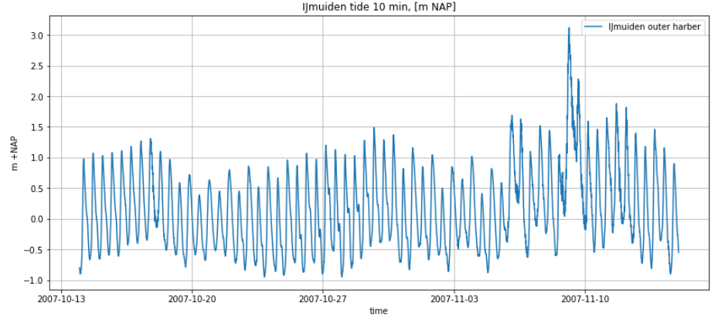
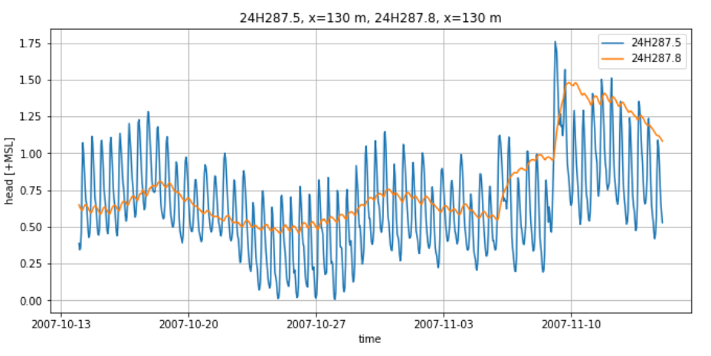
Tide in groundwater
Tide cycle duration = 12:25 h
storm
1.65 m
phreatic
0.62 m
0.045 m
semi-confined

Slide 11
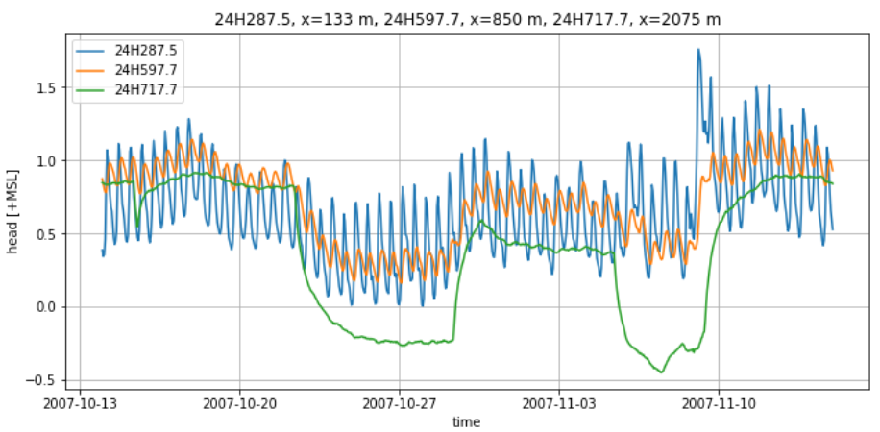
storm
1.65 m
extraction
extraction
0.62 m
0.18 m
ca. 0.02 m

Slide 12
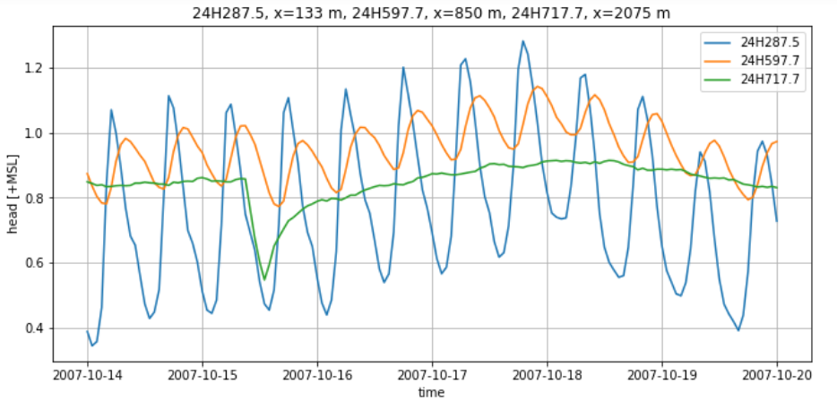
Delay 2.5 h

Slide 13
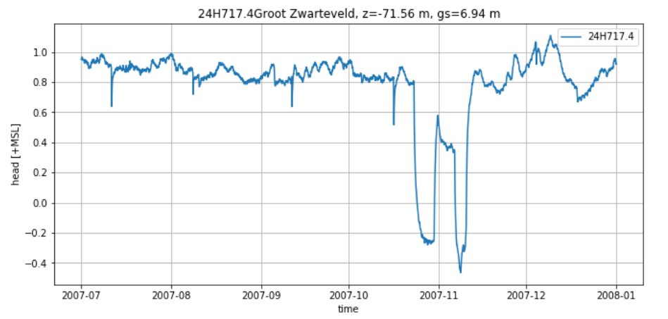
Effect of puming on head in semi-confined aquifer

Slide 14
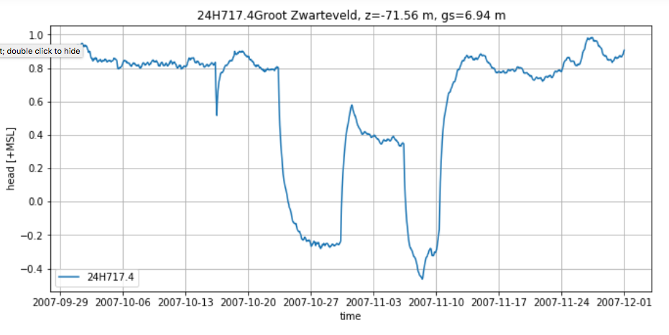
Drawdown by pumping

